Slide 1
Docker Use Case 1 - IBM BDA
Hurricane Hackers
Sindhu Reddy Golconda
Simon Moeller
Prudhvi Raj Mudunuri
Sudhakar Reddy Peddinti

Slide 2
Use Case Statement
Design a Docker manager application. This application should include detection of node failure with automatic container failover, automatic container rebalancing between nodes, and dynamic inclusion and exclusion of available nodes. This Docker manager application should include an easy to use CLI for adding containers, removing containers, displaying container status, and displaying node status.

Slide 3
High level solution design
User CLI - Allows use to add and remove containers, add and remove nodes, allows user to view container and node status
Node manager - monitors nodes through direct API calls to VirtualBox, generates events on node status change between healthy/unhealthy
Container manager - monitors containers through direct API calls to Docker, starts, stops, and removes containers
Rebalancer engine -
Rebalances container load across all nodes when nodes come online/become healthy
Iteratively redistributes containers across remaining nodes when a node goes offline/becomes unhealthy, until either there are no containers left to redistribute or the node becomes healthy
Healthy is defined as available, and loading below maximum thresholds
Unhealthy is defined as either unavailable, or loading above maximum thresholds

Slide 4
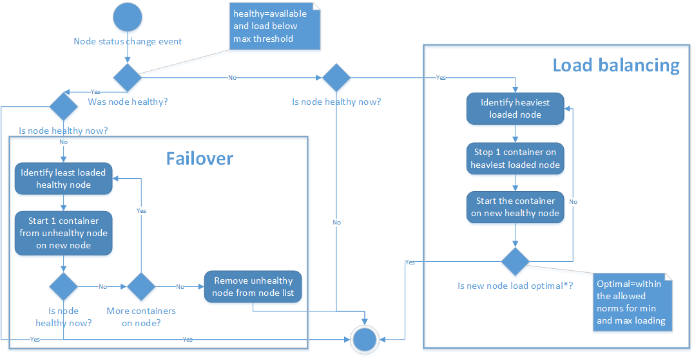
Rebalancer engine

Slide 5
References
Docker-client Java API, https://github.com/spotify/docker-client
VirtualBox SDK, http://download.virtualbox.org/virtualbox/

